Slide 1
Database System
Development Lifecycle
Database Systems
Database Planning, Design, and Administration
Notes:
Database Systems (Spring 2011) - Naveed Anwer Butt @UOG

Slide 2
Systems Development Life Cycle
(figures 2.4, 2.5)
Project Identification
and Selection
Purpose –monitor, repair, enhance
Deliverable – periodic audits
Project Initiation
and Planning
Analysis
Logical Design
Physical Design
Database activity –
database maintenance
Implementation
Maintenance

Slide 3
Database Design
Process of creating a design for a database that will support the enterprise’s mission statement and mission objectives for the required database system.

Slide 4
Preliminary investigation/survey project
During this phase scope of the problem is defined including end-users, perceived problems and technical constraints, perceived project goals and possible solution also called the problem definition phases .

Slide 5
Preliminary investigation objectives
Obtain an authorization for the preliminary investigation
Identify the information that you need to gather
Obtain organization charts for those departments undergoing study to determine who should be interviewed
Conduct interviews to obtain information
Review current system documentation and observe current operations to obtain information
Correlate the information you acquire and present your results and recommendations to management.

Slide 6
The organization of a preliminary investigation report
Introduction
Systems Request Summary
Findings
Recommendations
Time and cost Estimates
Expected benefits

Slide 7

System Analysis Phase

Slide 8
System Analysis Phase
To learn exactly what take place in the current system
To determine and fully document in detail what should take place, and to make recommendations to management on the alternative solutions and their cost.

Slide 9
3 Steps framework
Get the facts
Analysis the facts
Make a decision
  this simple three-step approach provides a sound framework with which to solve systems problems

Slide 10
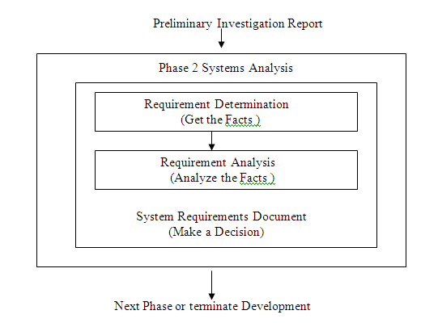
The three steps of decision-making and their application to the systems analysis phase of the system developing life cycle.

Slide 11

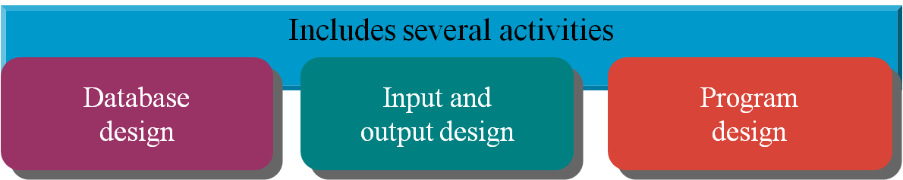
What is Database Design

Slide 12
Database Design
Main purposes of data modeling include:
  to assist in understanding the meaning (semantics) of the data;
  to facilitate communication about the information requirements.
Building data model requires answering questions about entities, relationships, and attributes.

Slide 13
Database Design
A data model ensures we understand:
  - each user’s perspective of the data;
  - nature of the data itself, independent of its physical representations;
  - use of data across user views.

Slide 14
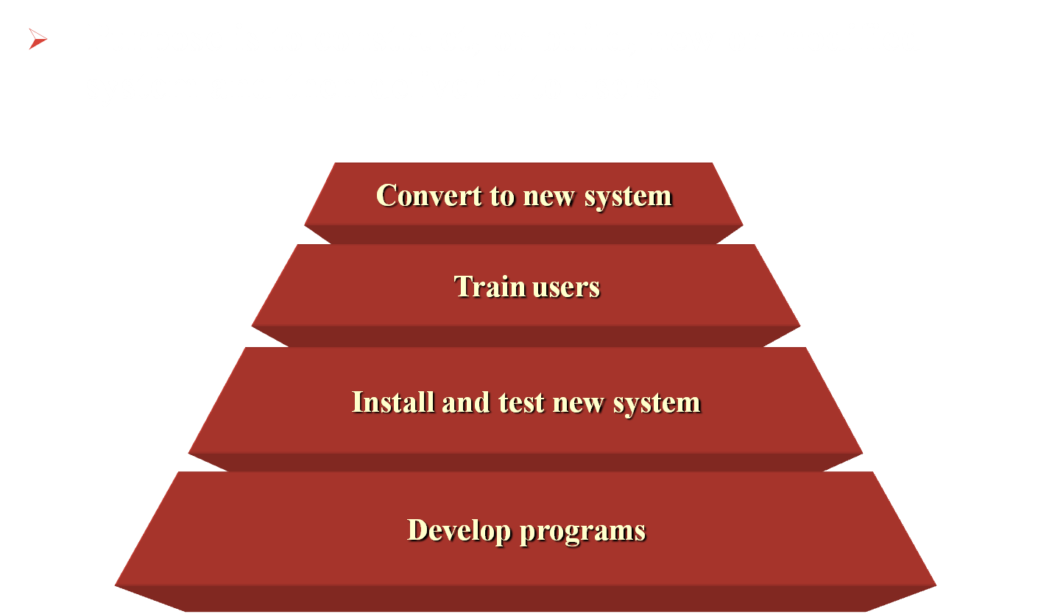
What is the implementation phase?

Slide 15
What is maintenance?
“It is post-implementation software development, designed to ensure the continued effectiveness of the software in question.”
How should maintenance be managed?
  “Cradle-to-grave”; those who built it, maintain it.
  Separate maintenance department.
  Outsource the maintenance to a third party

Slide 16
Prototyping
Building working model of a database system.
Purpose
  to identify features of a system that work well, or are inadequate;
  to suggest improvements or even new features;
  to clarify the users’ requirements;
  to evaluate feasibility of a particular system design.

Slide 17
Data Conversion and Loading
Transferring any existing data into new database and converting any existing applications to run on new database.
Only required when new database system is replacing an old system.
  DBMS normally has utility that loads existing files into new database.
May be possible to convert and use application programs from old system for use by new system.

Slide 18
Testing
Process of running the database system with intent of finding errors.
Use carefully planned test strategies and realistic data.
Testing cannot show absence of faults; it can show only that software faults are present.
Demonstrates that database and application programs appear to be working according to requirements.

Slide 19
Operational Maintenance
Process of monitoring and maintaining database system following installation.
Monitoring performance of system.
  if performance falls, may require tuning or reorganization of the database.
Maintaining and upgrading database application (when required).
Incorporating new requirements into database application.

Slide 20
CASE Tools
Support provided by CASE tools include:
  - data dictionary to store information about database system’s data;
  - design tools to support data analysis;
  - tools to permit development of corporate data model, and conceptual and logical data models;
  - tools to enable prototyping of applications.

Slide 21
CASE Tools
Provide following benefits:
  Standards
  Integration
  Support for standard methods
  Consistency
  Automation

Slide 22
Data Administration and Database Administration
The Data Administrator (DA) and Database Administrator (DBA) are responsible for managing and controlling the corporate data and corporate database, respectively.
DA is more concerned with early stages of database system development lifecycle and DBA is more concerned with later stages.

Slide 23
Data Administration
Management of data resource including:
  database planning,
  development and maintenance of standards, policies and procedures, and conceptual and logical database design.

Slide 24
Database Administration
Management of physical realization of a database system including:
  physical database design and implementation,
  setting security and integrity controls,
  monitoring system performance, and reorganizing the database.

